Slide 1

DATA-DRIVEN INSIGHTS FOR HATE SPEECH DETECTION
Data Warehouses (project) - Monday (odd), 13:15
Team:
Dawid Galik 205780
Jakub Gałązka 250060
Dominika Rzepka 271301 Mateusz Guściora 228884

Slide 2


AGENDA
01
05
02
06
03
07
AI MODEL FOR HATE SPEECH PREDICTION
PROJECT GOAL & PROBLEM
DATASET OVERVIEW
IMPLEMENTATION
TARGET USER PROFILE
PROJECT TIMELINE
04
ARCH. TOOLS & TECH.
08
CONCLUSIONS
1

Slide 3


PROJECT GOAL & PROBLEM
Project's goal:
Leverage data intelligence to identify and analyze hate speech
Design and implement system that handles data from different sources
Problem Statement:
Detection of hate speech across various platforms
Volume of data
Different sources
Dayily Snapshots
2

Slide 4




PROJECT TIMELINE
Kickoff and Planning
Parallel Development Phase 1
Parallel Development Phase 2
Parallel Development Phase 3
Integration and Testing
Final Presentation and Reporting
13.11 – Project Kickoff and Planning
20.11 – Initial Setup and Framework Development
27.11 – First Integration Meeting
04.12 – Data Ingestion and Storage Structure Implementation
11.12 – Midterm Review and Integration Checkpoint
18.12 – Advanced Development and Integration
25.12 – Second Integration Meeting
01.01 – User Experience and Feedback Integration
08.01 – Pre-Release Testing and Final Integration
15.01 – Final Project Report and Presentation
13
Notes:
Kickoff and Planning
13.11 – Project Kickoff and Planning
Introduce project scope and objectives to all team members.
Assign individual roles aligned with the four major themes.
Establish a communication plan for regular updates and integration points.
Develop a detailed project plan including dependencies between workstreams.
Parallel Development Phase 1
20.11 – Initial Setup and Framework Development
Each team member begins setting up their environment based on their theme.
Initial data extraction methods are defined.
Preliminary storage solutions are established.
Begin conceptual work on data analysis and visualization approaches.
27.11 – First Integration Meeting
Team members present their initial frameworks.
Discuss and synchronize data structures and formats to ensure compatibility.
Establish version control and project management tools.
Parallel Development Phase 2
04.12 – Data Ingestion and Storage Structure Implementation
Data ingestion processes are implemented and tested.
Storage solutions are refined and prepared for scaling.
Initial AI model integration is tested with sample data.
Visualization and decision support frameworks are sketched out.
11.12 – Midterm Review and Integration Checkpoint
Review progress on all fronts.
Share preliminary results and integrate the AI model outputs with visualization tools.
Prepare for the midterm presentation by ensuring all components are represented.
Midterm Presentation
Midterm Milestone and Presentation
Conduct a comprehensive review of each workstream.
Present the integrated system as it currently stands.
Document feedback and outline steps for the next phase.
Parallel Development Phase 3
18.12 – Advanced Development and Integration
Further refine the data pipeline with a focus on transformation and preprocessing for AI.
Scale the storage solutions to handle larger datasets.
Enhance the AI model with additional training and evaluation.
Develop advanced visualization features and interactive elements for decision support.
25.12 – Second Integration Meeting
Share updates and progress within each theme.
Address any integration issues encountered.
Plan for the final stretch of development with a focus on polishing features.
Finalization and Testing
01.01 – User Experience and Feedback Integration
Conduct user testing sessions.
Collect and integrate feedback into each theme.
Start preparing for the final presentation and report.
08.01 – Pre-Release Testing and Final Integration
Perform thorough testing of the entire system.
Finalize integration across all themes.
Begin compiling results and insights for the final report.
Final Presentation and Reporting
15.01 – Final Project Report and Presentation
Finalize and review the integrated data platform.
Prepare the final project report with detailed analysis and conclusions.
Present the completed system and discuss potential future work.

Slide 5
DATASETS OVERVIEW
From HuggingFace - „enryu43/twitter100m_tweets”
https://huggingface.co/datasets/ucberkeley-dlab/measuring-hate-speech
3

Slide 6

TARGET USER PROFILE
End user:
NGOs
User Needs:
Reporting
Decision-Making support
Daily Monitoring
4

Slide 7



ARCHITECTURE
Data Collector
Database
Basic Preprocess
Structured Data
Analysis Results
Dashboard Interface
HugginFace datasets
Simulated Twitter API
Raports
AI Models
Data Preprocessor
5

Slide 8

Tools and Technologies
ID | Module | Tool and Technology
1 | Data Collector | Python
2 | Storage | MySQL
3 | Analysis & ML | PyTorch / HuggingFace Transformers
4 | Dashboard Interface | PowerBI
6

Slide 9

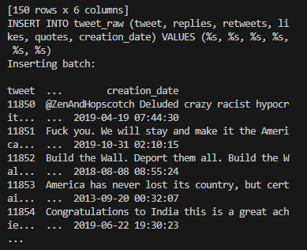
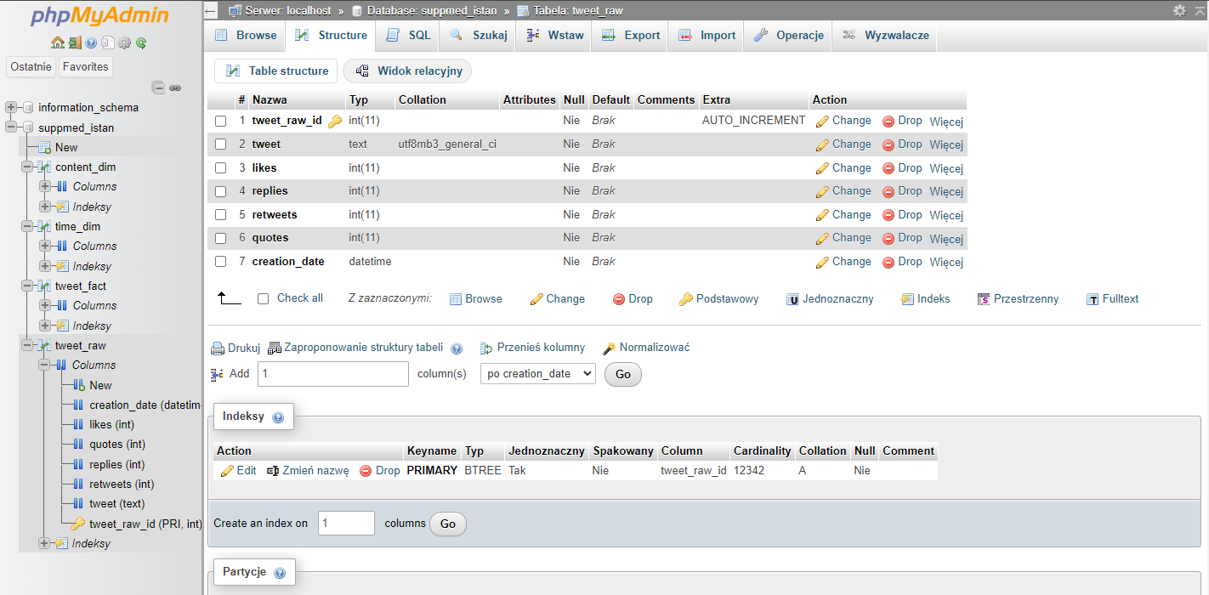
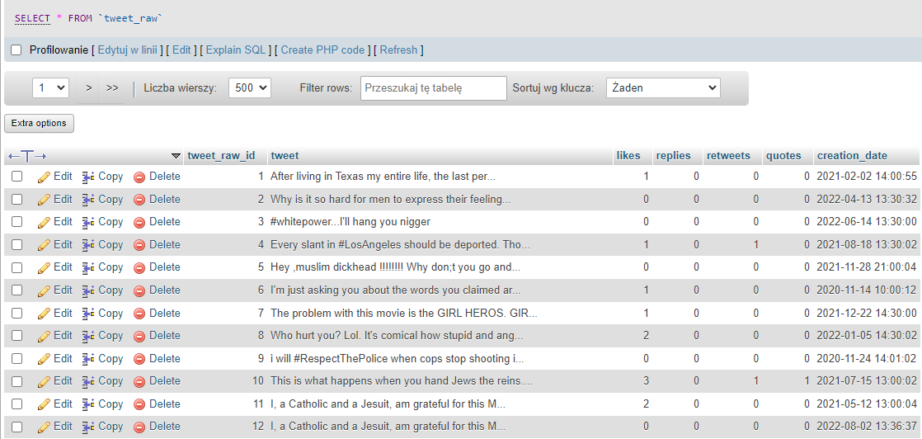
DATA COLLECTION
Load
Batch and Insert Into DataBase
7

Slide 10
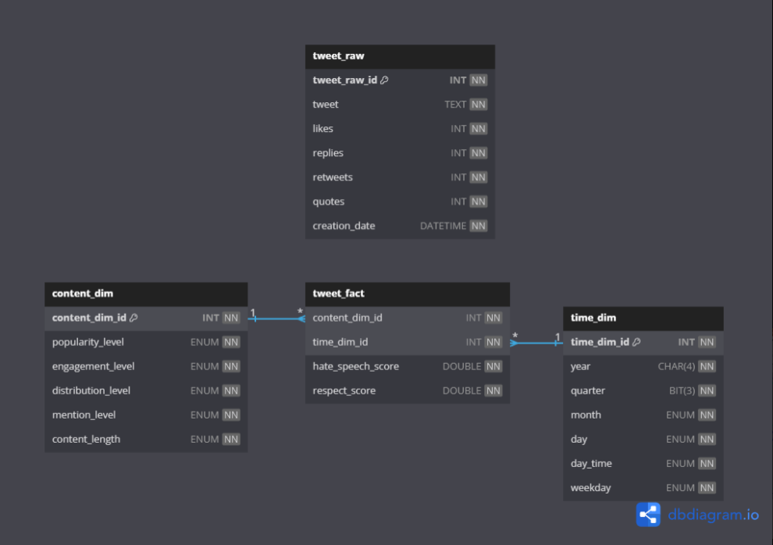
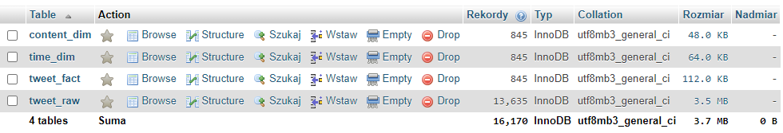
DATA STORAGE
Star Schema
Dimensions
Fact Table
8

Slide 11
AI MODEL FOR HATE SPEECH SCORE PREDICTION
Implements a regression task to generate a continuous hate speech score
Dataset: UC Berkeley D-Lab's Measuring Hate Speech dataset
Model enabling consistent hate speech detection within English Language
Score Interpretation:
hate_speech_score: A continuous measure ranging from highly supportive to extremely hateful speech
> 0.5: Likely hate speech
-1 to +0.5: Neutral or ambiguous speech
< -1: Counter speech or supportive content
9

Slide 12
AI MODEL FOR (DIS)RESPECT SCORE PREDICTION
Implements a regression task to generate a continuous (dis)respect score
Dataset: UC Berkeley D-Lab's Measuring Hate Speech dataset
Model enabling consistent respect detection within English Language
Score Interpretation:
respect_score: A continuous measure ranging from highly respectful to extremely disrespectful
0 - Very Respectful
1 - Somewhat Respectful
2 - Neutral
3 - Somewhat Disrespectful
4 - Very Disrespectful
10

Slide 13
DASHBOARDS
11

Slide 14
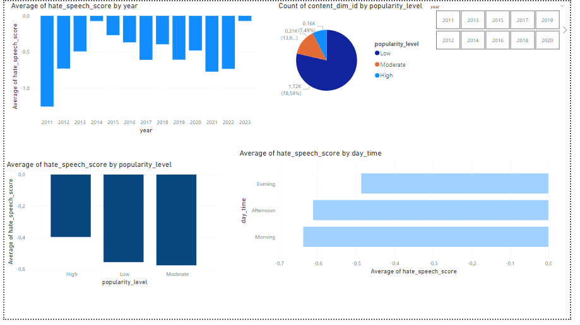
RAPORT 1 – Hate Speech Score
12

Slide 15
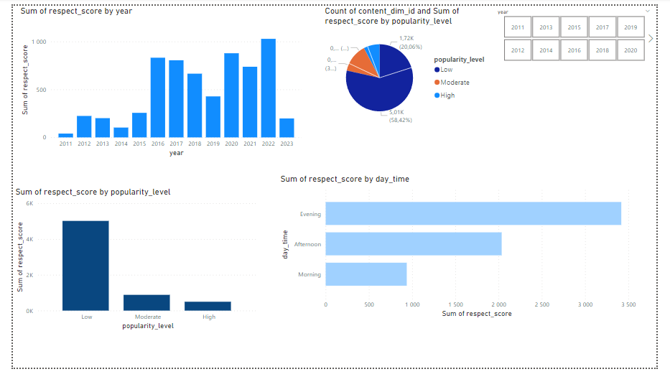
RAPORT 2 – Respect Score
13

Slide 16

Q&A
14

Slide 17
THANK YOU!
15

